Slide 1
To do list
By: Radwan Elshafiey & Youssef Othman

Slide 2
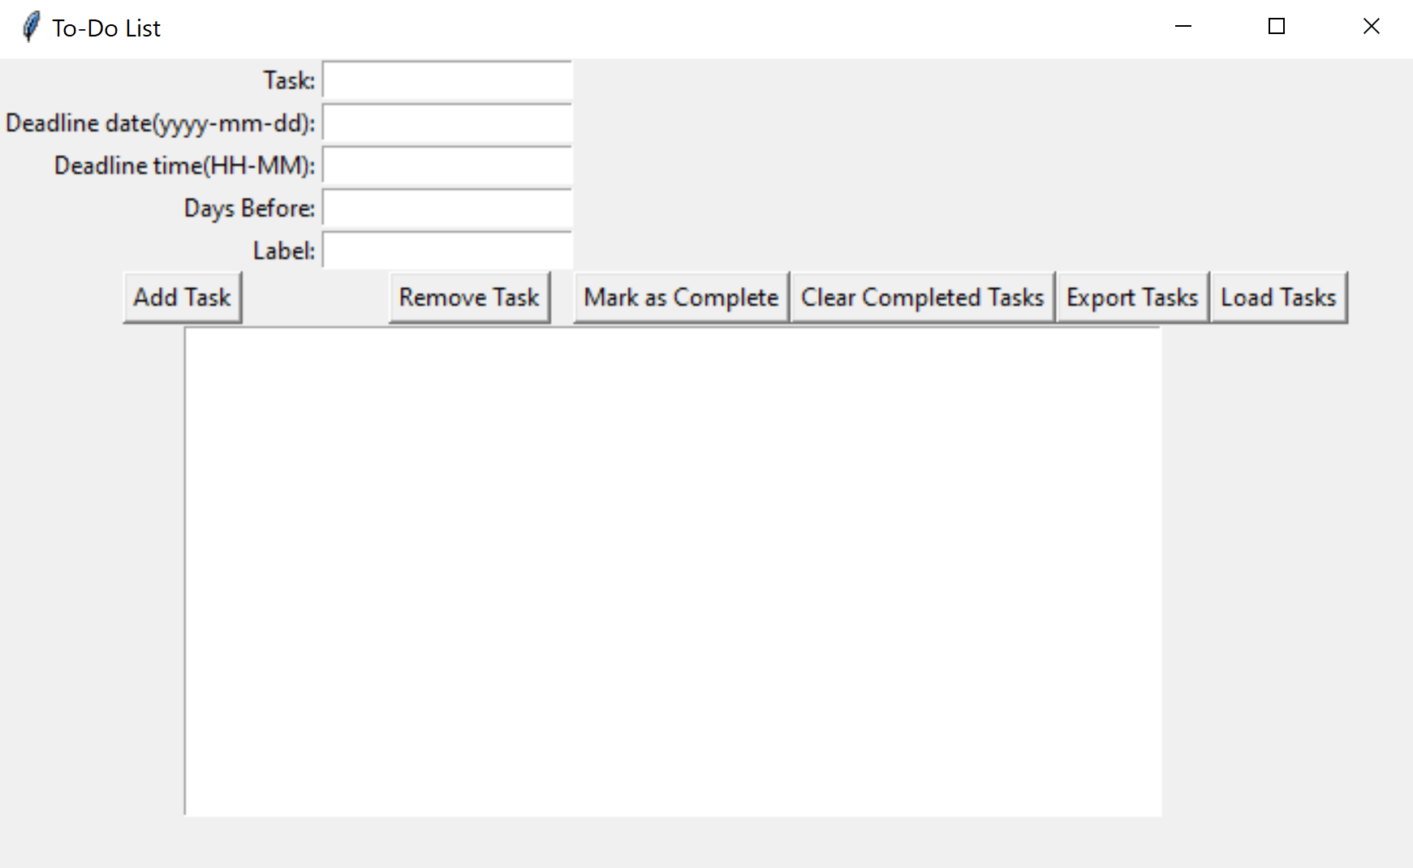
First open
When you first open the project you are greeted by this display. To start you will write your task, write the deadline of the task, write the days before you would like to be reminded, and add the task label.
After you write the data you will click on the “Add Task” button.

Slide 3
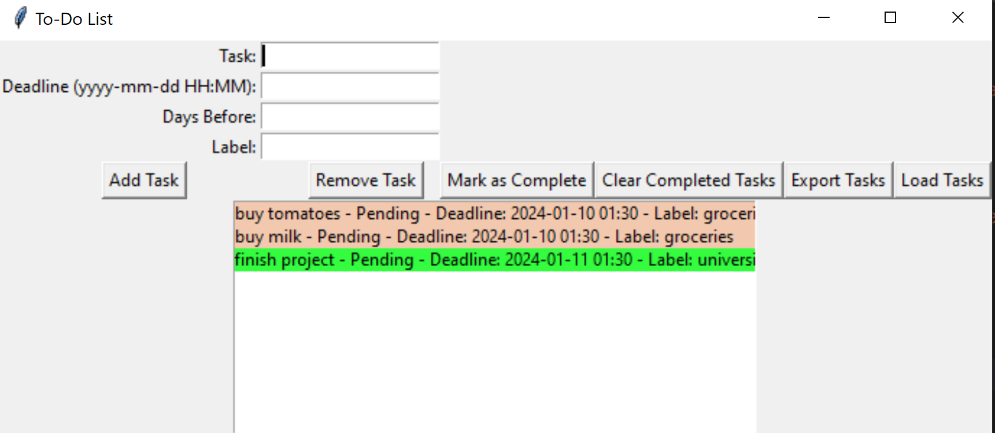
Labels
When you add your tasks you will notice that all the tasks with the same label are highlighted in the same color. This will make it easier for you to know what things are related to each other.
P.S: if you want to delete a task simply select the task then click on the “Remove Task” button.

Slide 4
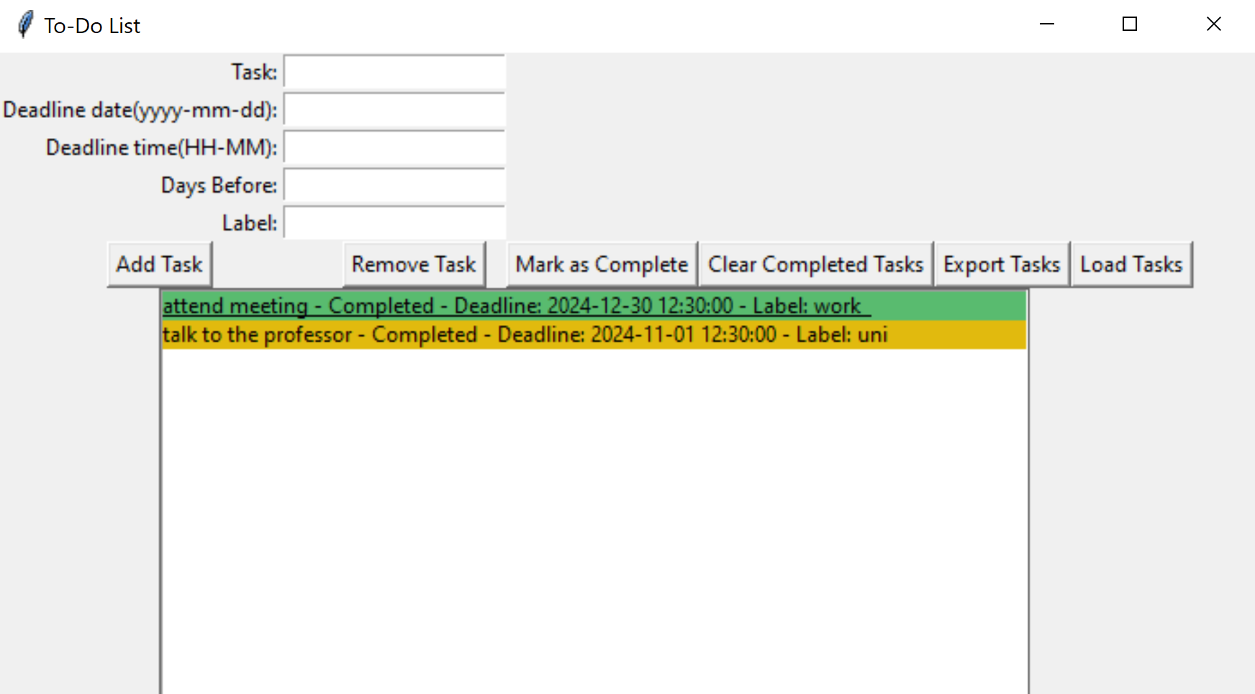
Complete, and clear completed
Once you have completed a task you can mark it as complete using the “Mark as Complete” button.
Next to the task you will see whether its completed or not.
If you click on the “Clear Completed Tasks” button it will remove all tasks marked as complete from the to do list.

Slide 5
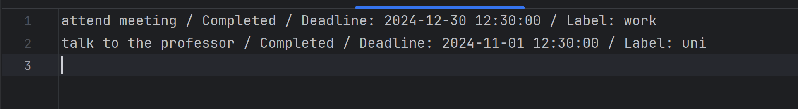
Export tasks
If you want to put all your tasks in a file you will click on the “Export Tasks” button.
The resulting file will type the task, whether it’s completed or pending, its deadline, and label

Slide 6
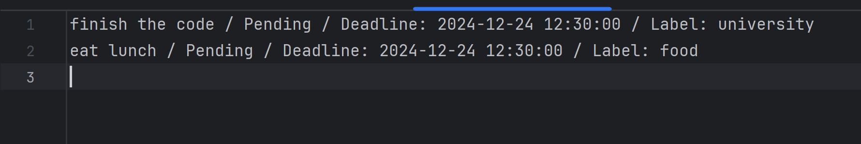
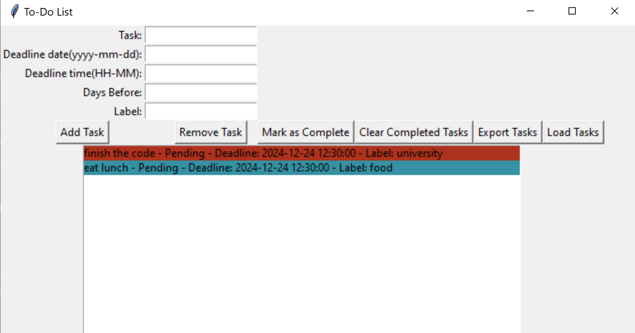
Import Tasks
If you have a list of tasks in a file you can upload them using the “Load Tasks” button.
The result will upload the tasks in the to do list as shown here.

